Slide 1
Python Modules to Work with Images

Slide 2
Course Outline
Discuss image data and their characteristics
Use Python modules to load images
Use Python modules to resize image
Use Python modules to crop images
Use Python modules to save images

Slide 3
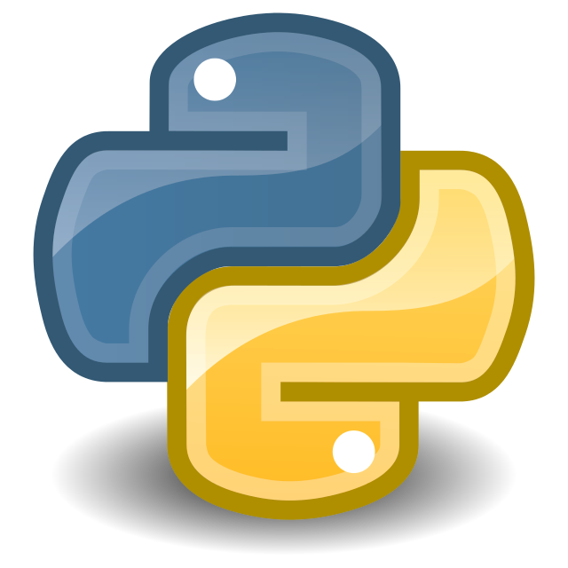
Contents
What is Image
Image Data and their characteristics
Python Libraries involved in Image Processing
OpenCV, Scikit-image and Pillow Library for
loading images
resizing image
cropping images
saving images

Slide 4
Image
A binary image consists of 1 bit/pixel and so can have only two possible colors, i.e., black or white. Black is represented by the value 0 while 1 represents white.
Grayscale - A pixel is an integer with a value between 0 to 255 (0 is completely black and 255 is completely white). If converted to float datatype, value between 0 to 1.
RGB - A pixel is made up of 3 integers between 0 to 255 (the integers represent the intensity of red, green, and blue). If converted to float datatype, it values between 0 to 1.
RGBA - It is an extension of RGB with an added alpha field, which represents the opacity of the image.

Slide 5
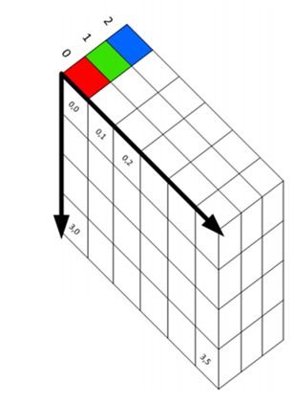
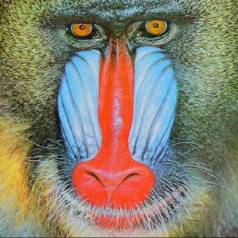
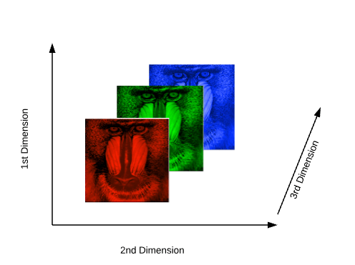
Image Data
Figure: image in the form of a three-dimensional array [1]

Slide 6
Libraries Involved in Image Processing
OpenCV
Scikit-image
Matplotlib
Pillow

Slide 7
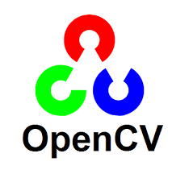
OpenCV
OpenCV is an opensource library which supports for implementing computer vision applications such as image processing and video analytics.
OpenCV is written in C++ programming language and has more than 2500 optimized algorithms for analytical processing.
Installation Syntax:
pip install opencv - python

Slide 8
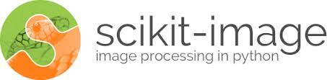
Scikit-image
Scikit-image is an image processing package in python programming language.
It provides with a set of efficient and optimized tools for for image processing and computer vision domain.
It basically works with Numpy arrays which are helpful in dealing with images and hence converting them to numbers.
Installation pre-requisite: NumPy and SciPy to be pre-installed.
Installation Syntax:
pip install -U scikit-image

Slide 9
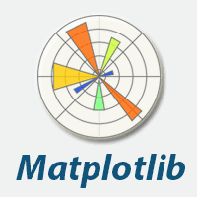
Matplotlib
Matplotlib library is an extension of Numpy which helps in plotting the numeric values onto various types of planes and plots.
It is very important library when it comes to data visualization.
It helps in creating static, animated, and interactive visualizations in Python.
Installation Syntax:
pip install matplotlib

Slide 10
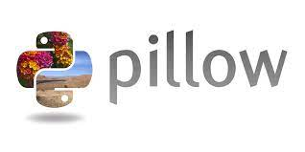
Pillow
Pillow is a fork of PIL where, PIL stands for Python Imaging Library.
Pillow is a open-source python library which is useful in opening, manipulating, and saving images into various different types of file formats.
It incorporates lightweight image processing tools that aids in editing, creating and saving images.
Installation Syntax:
pip install pillow

Slide 11

Image processing with OpenCV: Load image
Importing required libraries for OpenCV implementation in python.
Read in the image using the imread function
Printing the type and shape of the array

Slide 12
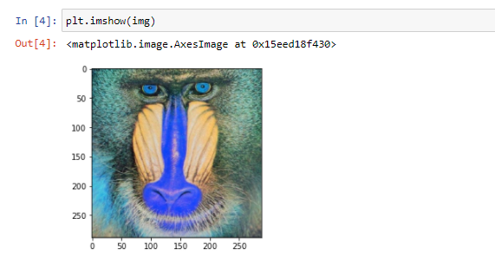
Image processing with OpenCV: Display image
Plotting the result.

Slide 13
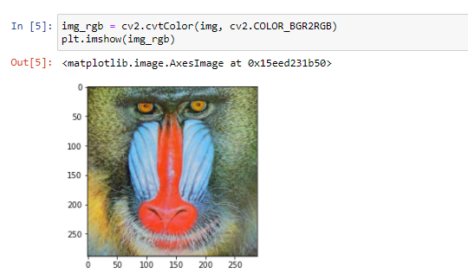
Image processing with OpenCV: Convert Color space
Convert Image from BRG to RGB colour space using OpenCV using cvtColor function.

Slide 14
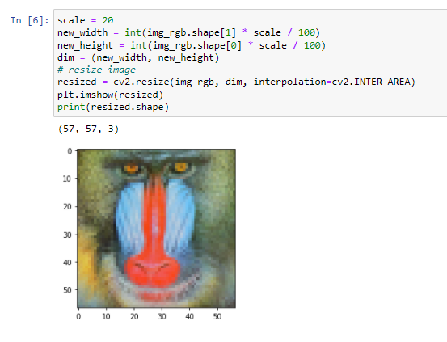
Image processing with OpenCV: Image resizing
Image Resizing:

Slide 15
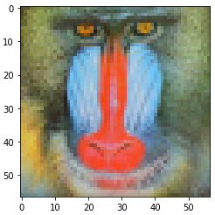
Image processing with OpenCV: Image resizing
Result: Resized Image
(57, 57, 3)

Slide 16
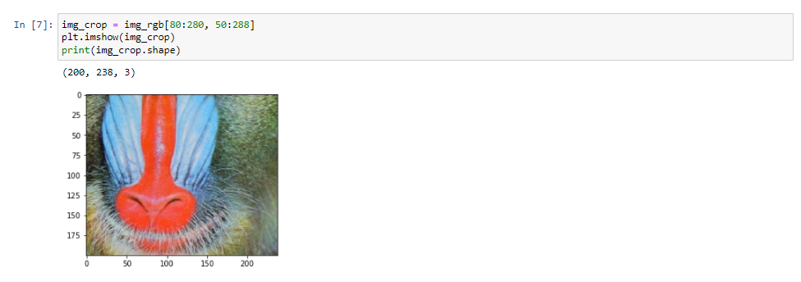
Image processing with OpenCV: Crop Images
Cropping the image:

Slide 17
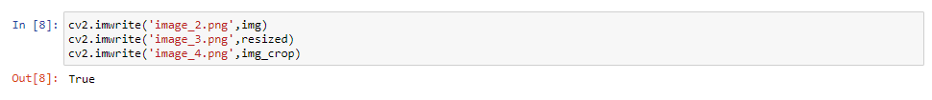
Image processing with OpenCV: Save image
Saving the images using imwrite function in OpenCV.

Slide 18

Image processing with Scikit-image: Load image
Importing required libraries in for Scikit-image implementation in python.
Read in the image using the imread() function
Printing the type and shape of array formed from that image.

Slide 19
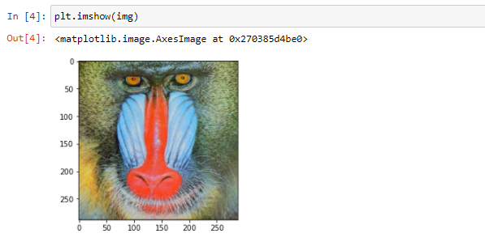
Image processing with Scikit-image : Display image
Plotting the results.

Slide 20
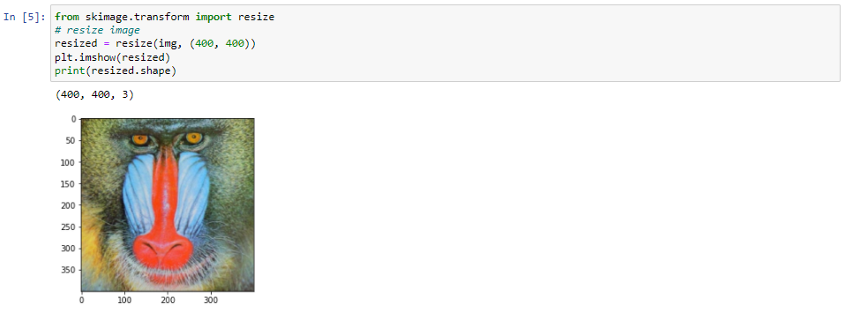
Image processing with Scikit-image : Image resize
Image resize using
resize function.

Slide 21
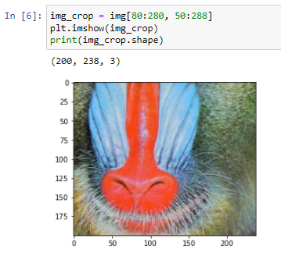
Image processing with Scikit-image : Crop Images
Cropping the image:

Slide 22
Image processing with Scikit-image : Save image
Saving the images using imsave function in Scikit-image.

Slide 23
Image processing with Pillow: Load image
Importing required libraries for Pillow implementation in python.
Read in the image using the open() function
Printing the type and shape of the array

Slide 24
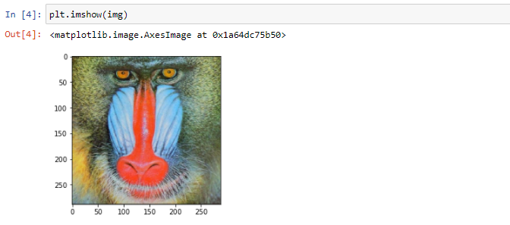
Image processing with Pillow: Display image
Plotting the results

Slide 25
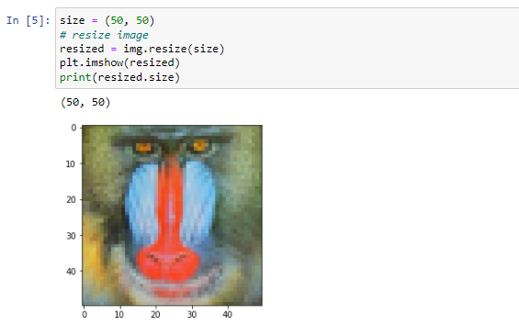
Image processing with Pillow: Image resize
Image resize using resize function.

Slide 26
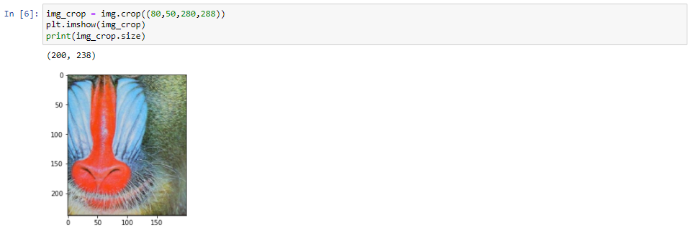
Image processing with Pillow: Crop Images
Cropping the image:

Slide 27
Image processing with Pillow: Save image
Saving the images using save function in Pillow

Slide 28
Assignment
Demonstrate loading of images in python using different libraries like OpenCV, Scikit Image, PIL.
Demonstrate resizing of images in python using different libraries like OpenCV, Scikit Image, PIL.
Demonstrate cropping of images in python using different libraries like OpenCV, Scikit Image, PIL.
Demonstrate saving of images in python using different libraries like OpenCV, Scikit Image, PIL.

Slide 29
Reference
https://www.datacamp.com/community/tutorials/face-detection-python-opencv#opencv-python
https://scikit-image.org/
https://opencv.org/
https://pillow.readthedocs.io/en/stable/
https://web.uri.edu/ltrs/files/NRS516_Characteristics-of-Digital-Imagery.pdf

